Slide 1
Microservices and Container Security
Web Development Day 2
‹#›

Slide 2
Class Objectives
By the end of today’s class, we’ll be able to:
Understand how microservices and architecture work to deliver more robust, reliable, and repeatable infrastructure as code.
Run a container vulnerability and filter through the results.
Deploy a Docker Compose container set and test the deployment functionality.
Deploy a container IDS and emulate intrusions on the previously deployed container set.
‹#›

Slide 3
Application Structure
‹#›

Slide 4

Introduction to Microservices
Today, we’ll set up and secure microservices. First, we’ll need to understand the following:
How an application and its components are organized.
How information flows between components of an application.
How application architecture has changed from monoliths to microservices.
How to deconstruct a monolith into microservices.
‹#›
Notes:
Image source: shutterstock_763372021

Slide 5
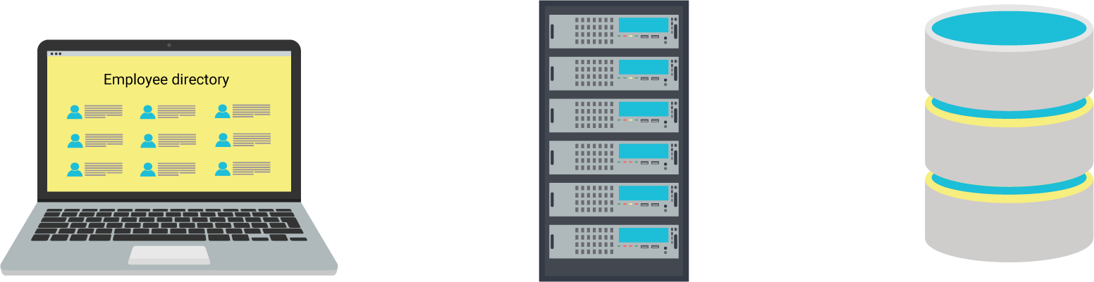

Components of a Typical Web App
Front-end server
To display webpages and style them in readable formats. Also responsible for receiving and responding to HTTP requests.
A developer, Andrew, often uses a browser to manage a public-facing employee directory application to retrieve and update different kinds of employee lists from his company.
The employee directory application is set up so that Andrew can add, remove, and view employees.
The employee directory application needs to access the following components:
Back-end server
Executes business logic and writes or reads corresponding data to and from a database.
Database
Stores information about employees, such as their employee IDs and names.
Image source: shutterstock_329468402, shutterstock_417078436
‹#›

Slide 6

Information Flows between Application Components
Andrew loads the application in his browser and clicks a button to see all HR employees.
Browser displays new page with a formatted list of HR employees.
Employee directory application
Front end prepares a new web page with a list of all HR employees.
Front end forwards request to back end.
Front-end server
A backend script queries the database for HR employees.
Back-end script forwards list of HR employees to front end.
Back-end server
Database searches for all IDs with “HR.”
Database sends IDs with “HR” to back end.
Database
‹#›

Slide 7
Monolith to Microservices
‹#›

Slide 8

Understanding the components of an application is key to understanding the modern architectural paradigm of microservices.
First, we need to understand the original architecture type, the monolith, and the issues that led to the adoption of microservices.
Notes:
Image source: shutterstock_1083618569

Slide 9
Monolith
A monolith is a singular machine that hosts all the components required to serve a website or application.
In other words, a monolith is a machine that has a front-end server, back-end server, and a database.
‹#›

Slide 10
Monolith
1
Suppose Amazon is using a monolithic server. It would contain:
Front-end HTML server: GUI for customers to look at while shopping.
Back-end MySQL server: Back-end server showing the inventory and stock.
MySQL database: Database of customers, and their information and purchases.
1
2
2
3
3
‹#›

Slide 11
Monolith
1
The components of a singular machine are highly dependent on each other. If any component malfunctions, the entire application will malfunction.
Hackers, environmental issues, and human errors can threaten the entire machine.
Updating a single component means taking down all components, resulting in downtime and lack of availability.
2
3
‹#›

Slide 12
Problems with Monoliths
It’s now expected that companies will ensure availability by maintaining almost 100% uptime. The risk associated with a interdependent monolithic system presented problems.
Separating an application's components into their own machines (microservices) means the sysadmin can update the front end, reboot it, and only have to verify the front-end components, not the back-end components and database.
If a component is compromised by a hacker, the potential damage is restricted to only that component.
‹#›

Slide 13
Microservices
Each independent machine is a component that executes one primary function or service.
We’ve already implemented microservices in our cloud security week:
A jump box to connect to a private Ansible server.
An Ansible server to configure DVWA servers.
DVWA servers to provide the DVWA service.
A Docker image to provide WordPress.
‹#›

Slide 14

Benefits of Microservices
Scalability and resilience: Replication of components lets you serve more clients and provides identical backup components if one fails.
Rapid response: Since microservice components are inherently smaller, they can be replaced and updated quickly.
Isolated improvement: Since microservices serve one primary function, they can be developed with the goal of optimizing their functionality.
Isolated security: One compromised component does not equal a compromised application.
‹#›

Slide 15
APIs
‹#›

Slide 16

APIs
When Amazon customers want to retrieve a list of all the newest and most popular books, they do not go to the back-end MySQL server to check the inventory.
They go to the front-end microservice.
Then, the microservice communicates with the back-end server, and brings up the relevant data.
Customers do not have access to the back-end server. Backend does not accept HTTP requests, meaning users can't
communicate with it.
‹#›
Notes:
Image source: shutterstock_1049725370

Slide 17

APIs
Product directory app
Systems administrators need to access and query the back end to update product information.
Since they need to directly communicate with the back end, they must modify it to accept requests.
Software developers will program the back end to receive, from sources other than the front-end, HTTP requests to add, remove, and view product information.
Requests and responses for product info
Requests and responses for
product info
Product API
System Administrator
Database queries to interact with product info
The back-end server is an application programming interface (API): the implementation of new protocols or features onto an existing application to alter the way it is used or accessed.
Inventory database
‹#›
Notes:
Image source: shutterstock_1049725370

Slide 18

Challenges of Microservices
A product directory app is down? Rerouting users to the other two!
User requests
Terminated connection
Load balancer
Microservice complexity and interconnectivity also come with unique security issues.
Microservices have increased complexity and require more maintenance as the application and number of components grows.
Product
directory
apps
Requests and responses for product info
Product API
Database queries to interact with product info
Inventory database
‹#›
Notes:
Image source: shutterstock_1049725370

Slide 19
Monolith to Microservice
In the next activity, you will diagram microservices.
01
Separate each component of the monolith by its function and move into its own machine.
02
Add communication between each part of the microservice.
03
Turn the back-end server into an API to interact with more than just the front end.
04
Rename the rest of the component services to match the main function they provide.
‹#›

Slide 20
Activity: Monolith to Microservice
In this activity, you will diagram a microservice version of a monolith web store application.
15 Minutes
‹#›

Slide 21
‹#›

Slide 22
Container Vulnerability Analysis
‹#›

Slide 23
In this section, we’ll explore the underlying technologies of microservice machines and their associated vulnerabilities.
Notes:
Image source: shutterstock_1083618569

Slide 24

Microservice Infrastructure
Microservices require lightweight environments to run because:
Live services need to be deployed quickly.
Multiple copies of a service can be replicated as needed to meet demand.
Developers and maintainers can deploy their own copies of these services locally for testing purposes.
Full-sized VMs for each service require more resources and are more expensive.
‹#›

Slide 25

Each service needs its own lightweight virtual environment.
Can we think of any technologies that provide a lightweight, isolated environment?
‹#›
Notes:
Image source: shutterstock_1139926778

Slide 26
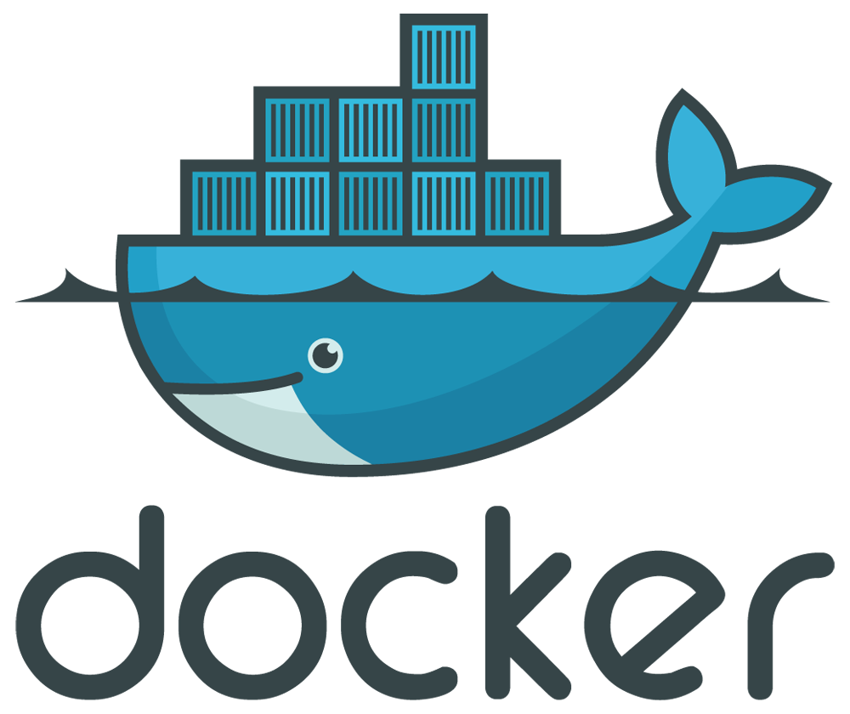
Microservice Infrastructure with Containers
In the cloud security unit, we covered containers and Docker extensively. We also used Ansible to set up lightweight containers in our activities.
Containers run as isolated, virtual operating systems that dynamically allocate resources depending on needs. This is unlike regular virtual machines, where all hardware is virtualized.
Docker is the most popular container platform.
For the rest of this class, we will be referring to Docker’s implementations of containers.
‹#›

Slide 27

Containerization is the process of packaging all the requirements for a microservice into a container.
‹#›
Notes:
Image source: shutterstock_1326085205

Slide 28
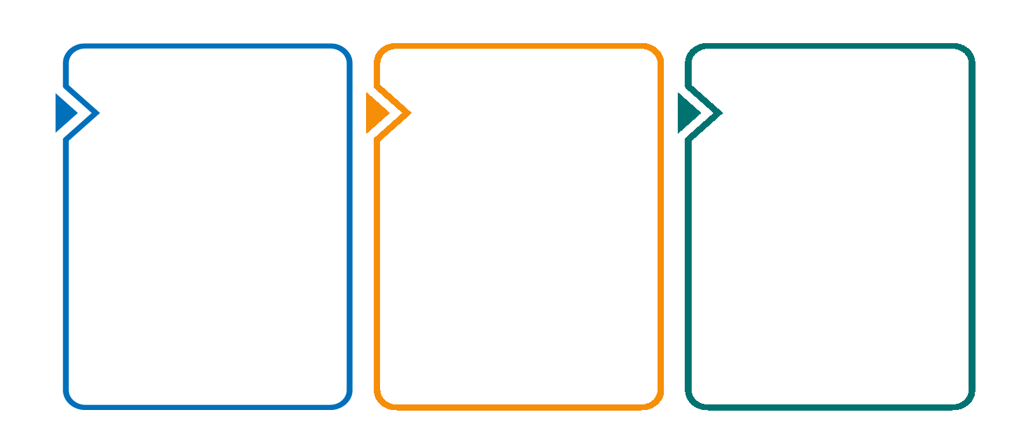
How a Container Becomes a Microservice
Containerizing a microservice requires the following steps:
Declare a base operating system for the microservice to run on.
Copy the microservice’s source code to the container.
Set a command that launches the microservice.
‹#›
Notes:
Image source: shutterstock_1367319962

Slide 29
Dockerfile
Containerization can be declared in a text file called a Dockerfile.
###############################
# Employee Directory Application
###############################
# Required Base OS
FROM ubuntu:14.04
...[truncated]
Dockerfiles contain all the configuration needed for a container in one file.
This is similar to an Ansible configuration file, which contains everything needed to configure a host with the command ansible-playbook your-playbook.yml.
‹#›

Slide 30
Dockerfile
A unique Dockerfile is created for each microservice.
#######################
# Product Directory Application
#######################
# Required Base OS
FROM ubuntu:14.04
Dockerfile
Product Directory app
Dockerfile
#######################
# PRODUCT API
#######################
# Required Base OS
FROM fedora:31
Product API
Dockerfile
#######################
# AMAZON Database
#######################
# Required Base OS
FROM centos:8
Amazon database
‹#›

Slide 31

Dockerfiles contain all the configurations needed to set up a container, but we also need to ensure the configurations do not come with security risks.
‹#›
Notes:
Image source: shutterstock_1083654293

Slide 32
Dockerfile
Security issues are inherited from the underlying operating system:
In this Dockerfile, Ubuntu 14.04 is the base operating system of the application.
All security issues present in Ubuntu version 14.04 will also exist in this container.
We will use a tool called Trivy to scan Dockerfiles and Docker images to create a list of known security issues.
###############################
# Employee Directory Application
###############################
# Required Base OS
FROM ubuntu:14.04
...[truncated]
‹#›

Slide 33
Vulnerability Scanning with Trivy
Some vulnerabilities we will look at are:
Man-in-the-middle (MITM): An attacker secretly intercepts and relays requests between a victim and their intended target, such as a website.
Buffer overflow: A software anomaly in which the memory of an application is corrupted and foreign code is executed as a part of memory.
Denial of service (DoS): Takes down a service and makes it unavailable.
Privilege escalation: Enables one to escape the regular user space of an operating system to run commands with elevated privileges
‹#›

Slide 34

Scanning container images and Dockerfiles before they are deployed is called vulnerability scanning.
It is one of the earliest stages in the application deployment process that security engineers become involved.
‹#›
Notes:
Image source: shutterstock_1247019490

Slide 35
Trivy
‹#›

Slide 36
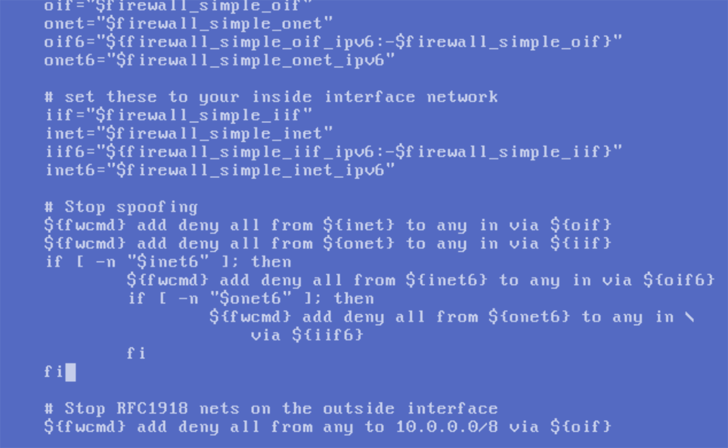
Bash Filtering
Now that we know how to use Trivy, we’ll filter the results using bash command-line tools.
We will need to use the command-line tool jq to inspect
the results.json file that we created with Trivy.
jq is like sed, but for JSON data. It’s used to filter
through JSON files and has the same text editing functionalities built into sed, awk, and grep.
JSON is a structured data format that is used often in software development languages, logging, and security.
‹#›
Notes:
Image source: wikipedia

Slide 37
JSON
While we won’t need to know JSON in depth, we’ll need to know how to interact with it using jq, to filter through vulnerability reports.
{;}
JSON
JavaScript Object Notation is a language-agnostic data format used for web services and APIs, as well as log aggregators such as ELK and Splunk.
‹#›
Notes:
Image source: shutterstock_765289405

Slide 38
JSON
A high level overview of JSON formatting:
{
"thisIsAKey":"this is a value",
"theFollowingIs":"an_array_example",
"ciaTriad":[ "confidentiality", "integrity", "availability" ]
}
It uses key:value pairs.
Data is separated by commas.
Curly braces can hold objects.
Square brackets hold arrays.
‹#›

Slide 39
JSON
A high-level overview of jq syntax. This searches through the Vulnerabilities in the first array (or listed data) of the results.json file.
jq '.[0].Vulnerabilities' results.json
VulnerabilityID: The Common Vulnerabilities and Exposures ID (CVD), a unique ID given to every vulnerability.
PkgName: contains the package name that is vulnerable.
InstallVersion: Version of the vulnerable package.
FixedVersion: Fixed version of the package.
Title: Title of the vulnerability.
Description: Description of the vulnerability.
Severity:The level of potential risk to the system it is installed on.
References: Links to more information.
‹#›

Slide 40
JSON
We can use pipes with our jq command to filter for specific results.
jq '.[0].Vulnerabilities[] | select(.Description | test("Man-in-The-Middle"))' results.json > results_mitm_vulns.json
This command will search the for the phrase “Man-in-the-Middle” in the description section of the vulnerabilities list of the result.json file.
It will then send those results to a new file named results_mitm_vulns.json.
‹#›

Slide 41
Activity: Container Vulnerability Analysis with Trivy and Bash
In this activity, you will use Trivy to scan a WordPress image, generate a comprehensive list of the most severe vulnerabilities, and create a report of your findings.
20 Minutes

Slide 42
‹#›

Slide 43
Deploying and Testing a Container Set
‹#›

Slide 44
Deploying at Scale
Deploying containers can be tedious, especially if a business requires hundred or thousands of microservices. Therefore we’ll need to know how to deploy in large-scale environments. Specifically, how to:
Deploy copies of containers we want replicated.
Set up a network for our containers so they can communicate with each other.
Deploy multiple types of containers at the same time.
For example, front-end and database services.
‹#›
Notes:
Image source: shutterstock_1367319962

Slide 45

Deploying at Scale
We’ll use Docker Compose to enable these large-scale deployments.
Docker Compose allows us to create repeated, multi-container deployments.
compose
Remember: We used Docker Compose in the last class to set up our WordPress site.
‹#›

Slide 46
Docker Compose YAML File
We also used YAML files to deploy Ansible playbooks during our cloud security unit.
version: "3.7"
services:
ui:
image: httpd:2.4
ports:
- 10000:8080
volumes:
- ./volume:/home
networks:
demo-net:
ipv4_address: 192.168.1.2
[truncated…]
Docker Compose uses YAML to define the containers, their networking configurations, and where you want to copy files from your host machine into your container.
‹#›

Slide 47
Docker Compose

Slide 48
Docker Compose Demo
In this demonstration, we will deploy multiple containers at the same time.
01
Examine the YAML file for its current configurations.
02
Launch our services with sudo docker-compose up.
03
Use our browser to verify the our front-end user interface (ui) services are deployed properly.
04
Test the deployment of our database (db) service.
05
Change the configuration of our UI service to display through a different port.
06
Test the new UI service’s functionality with our browser.
‹#›

Slide 49
version: "3.7"
services:
ui:
image: httpd:2.4
ports:
- 10000:8080
volumes:
- ./volume:/home
networks:
demo-net:
ipv4_address: 192.168.1.2
db:
image: mariadb:10.5.1
restart: always
environment:
MYSQL_DATABASE: demodb
MYSQL_USER: demouser
MYSQL_PASSWORD: demopass
MYSQL_RANDOM_ROOT_PASSWORD: "1"
volumes:
- db:/var/lib/mysql
networks:
demo-net:
ipv4_address: 192.168.1.3
networks:
demo-net:
ipam:
driver: default
config:
- subnet: "192.168.1.0/24"
volumes:
ui:
db:
This is a simple YAML file.
Let’s break it down.
‹#›

Slide 50
We’ll break down the file by the services it installs, the user interface, and the database.
The ui and db are services.
services:
ui:
db:
‹#›

Slide 51
image: Points to where Docker Compose will retrieve the container image on Dockerhub, which is Apache’s httpd container.
Ports: Ports this container will run on.
volumes: Local destination where the Apache server will save configuration files.
networks: The network that this service will connect to.
Ipv4_address: The static IP address we are assigning to this container.
ui:
image: httpd:2.4
ports:
- 10001:8080
volumes:
- ./volume:/home
networks:
demo-net:
ipv4_address: 192.168.1.2
‹#›

Slide 52
Standing up Scaled Services
‹#›

Slide 53
db:
image: mariadb:10.5.1
environment:
MYSQL_DATABASE: demodb
MYSQL_USER: demouser
MYSQL_PASSWORD: demopass
MYSQL_RANDOM_ROOT_PASSWORD: "1"
volumes:
- db:/var/lib/mysql
networks:
demo-net:
ipv4_address: 192.168.1.3
image: The container image and version we'll be using. (MariaDB database version 10.5.1)
environment: Containers within the MySQL server.
MYSQL_DATABASE: The name of the database.
MYSQL_USER: The default user for the database.
MYSQL_PASSWORD: The password for the user.
MYSQL_RANDOM_ROOT_PASSWORD: Gives the root user a random password, for security purposes.
volumes: The location where we are saving our configuration files.
networks: Assigns this database a static IP address using the same network (demo-net).
‹#›

Slide 54
Logging into MariaDB
‹#›

Slide 55
Activity: Deploying and Testing a Container Set
In this activity, you will deploy multiple containers with Docker Compose and test functionality.
‹#›

Slide 56
‹#›

Slide 57
Container Runtime IDS
‹#›

Slide 58
Now, we will combine our deployed container set with a container intrusion detection system (CIDS).
Notes:
Image source: shutterstock_1083618569

Slide 59
IDS Review
We covered IDS in out network security unit:
An intrusion is any unwanted malicious activity within a network or a system.
An IDS is a device or software application that monitors a network or system
for malicious activity.
A host-based intrusion detection system (HIDS) detects intrusion attempts on an endpoint device.
A network intrusion detection system (NIDS) detects intrusion attempts within a network.
‹#›

Slide 60
Container Intrusion Detection Systems (CIDS)
Containers have the same vulnerabilities as underlying VMs. But the large-scale deployment of containers vastly multiplies their attack surface.
Even though we scanned container Dockerfiles for vulnerabilities, we haven't done anything to secure the containers once they are deployed.
After container sets are deployed with tools like Docker Compose in live environments, we need to be able to detect intrusions.
Similar to NIDS and HIDS, container intrusion detection systems (CIDS) detect intrusions specifically for deployed containers.
The specific CIDS we will use today is called Falco.
‹#›

Slide 61

Falco is an open-source CIDS that alerts security professionals to potential intrusion attempts.
Common intrusion behavior on containers include:
New shell running inside a container. An unknown shell starting in a container signals an attacker has potentially accessed a system and will start executing commands.
When a sensitive file, such as /etc/shadow, is read. At no point during a container deployment should the contents of /etc/shadow be read. This is a clear sign that an attacker is retrieving the hashed passwords of accounts within the system.
Unprompted configuration changes. After an attacker gains access to a system, they will often create a user to maintain persistence within that system.
File creations at /root or /. At no point during a container's runtime should new files be created in the /root or / directories. Files created in these directories indicate compromise.
‹#›

Slide 62
In the upcoming demo, we will use Docker Compose deployment in conjunction with Falco to simulate an intrusion attempt and monitor the results.
Notes:
Image source: shutterstock_1083618569

Slide 63
CIDS
‹#›

Slide 64
Activity: Container Intrusion Detection System
In this activity, you will set up and test Falco on
the WordPress container.
20 Minutes
‹#›

Slide 65
‹#›

Slide 66
Next Week
In Unit 15, we will use the Web Vulnerabilities Azure Lab environment.
Inside of the Web Vulnerabilities environment are two nested VMs: a Kali Linux instance and a machine called owaspbwa.
The owaspbwa machine hosts the vulnerable web applications that we will use throughout the class, but we do not log into it.
Instead, we will perform all of our work on the Kali Linux instance.
Student credentials for the Kali machine:
Username: sysadmin
Password: cybersecurity
Take a moment to set up and access this environment. Troubleshoot any issues before class next week.

